Slide 1

DATA STRUCTURES

Slide 2
THREADED BINARY TREE
In the linked representation of binary trees, more than one half of the link fields contain NULL values which results in wastage of storage space.
If a binary tree consists of n nodes then n+1 link fields contain NULL values.
So in order to effectively manage the space, a method was devised by Perlis and Thornton in which the NULL links are replaced with special links known as threads.
Such binary trees with threads are known as threaded binary trees.
Each node in a threaded binary tree either contains a link to its child node or thread to other nodes in the tree.

Slide 3
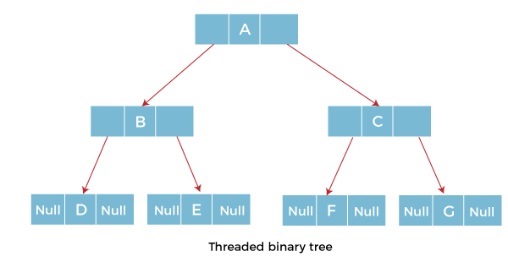

Slide 4
THREADED BINARY TREES - TYPES
There are two types of threaded Binary Tree:
One-way threaded Binary Tree
Two-way threaded Binary Tree

Slide 5
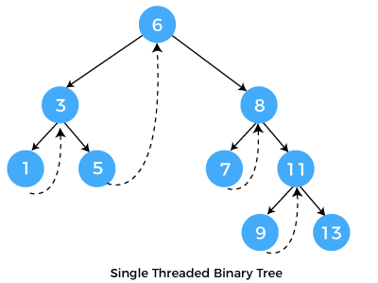
ONE WAY THREADED BINARY TREE

Slide 6
ONE WAY THREADED BINARY TREE
In one-way threaded binary trees, a thread will appear either in the right or left link field of a node.
If it appears in the right link field of a node then it will point to the next node that will appear on performing in order traversal.
Such trees are called Right threaded binary trees.
If thread appears in the left field of a node then it will point to the nodes in order predecessor.
Such trees are called Left threaded binary trees.

Slide 7
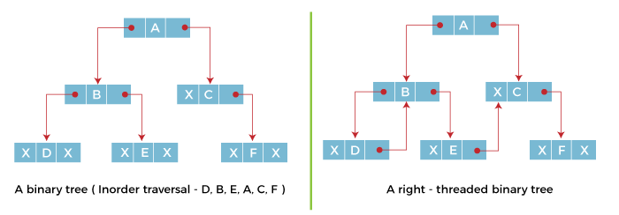

Slide 8

Two-way threaded Binary Trees
In two-way threaded Binary trees, the right link field of a node containing NULL values is replaced by a thread that points to nodes inorder successor and left field of a node containing NULL values is replaced by a thread that points to nodes inorder predecessor.

Slide 9
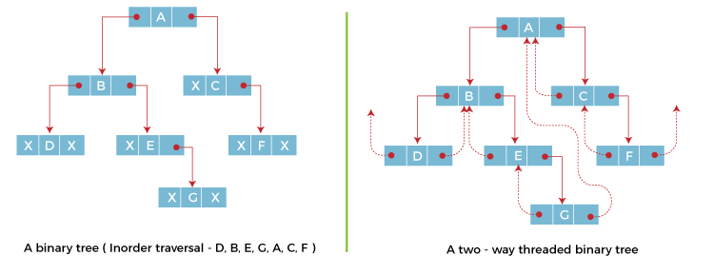
The above figure shows the inorder traversal of this binary tree yields D, B, E, G, A, C, F.
If we consider the two-way threaded Binary tree, the node E whose left field contains NULL is replaced by a thread pointing to its inorder predecessor i.e. node B.
Similarly, for node G whose right and left linked fields contain NULL values are replaced by threads such that right link field points to its inorder successor and left link field points to its inorder predecessor.
In the same way, other nodes containing NULL values in their link fields are filled with threads.

Slide 10
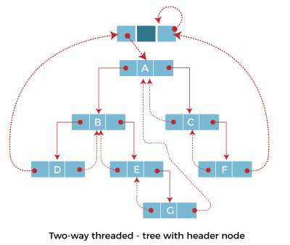

Slide 11
Advantages of Threaded Binary Tree
In threaded binary tree, linear and fast traversal of nodes in the tree so there is no requirement of stack. If the stack is used then it consumes a lot of memory and time.
It is more general as one can efficiently determine the successor and predecessor of any node by simply following the thread and links.
It almost behaves like a circular linked list.

Slide 12
Disadvantages of Threaded Binary Tree
When implemented, the threaded binary tree needs to maintain the extra information for each node to indicate whether the link field of each node points to an ordinary node or the node's successor and predecessor.
Insertion into and deletion from a threaded binary tree are more time consuming since both threads and ordinary links need to be maintained.

Slide 13
B Tree
B Tree is a specialized m-way tree that can be widely used for disk access.
A B-Tree of order m can have at most m-1 keys and m children.
One of the main reason of using B tree is its capability to store large number of keys in a single node and large key values by keeping the height of the tree relatively small.
A B tree of order m contains all the properties of an M way tree. In addition, it contains the following properties.
  Every node in a B-Tree contains at most m children.
  Every node in a B-Tree except the root node and the leaf node contain at least m/2 children.
  The root nodes must have at least 2 nodes.
  All leaf nodes must be at the same level.
  It is not necessary that, all the nodes contain the same number of children but, each node must have m/2 number of nodes.

Slide 14
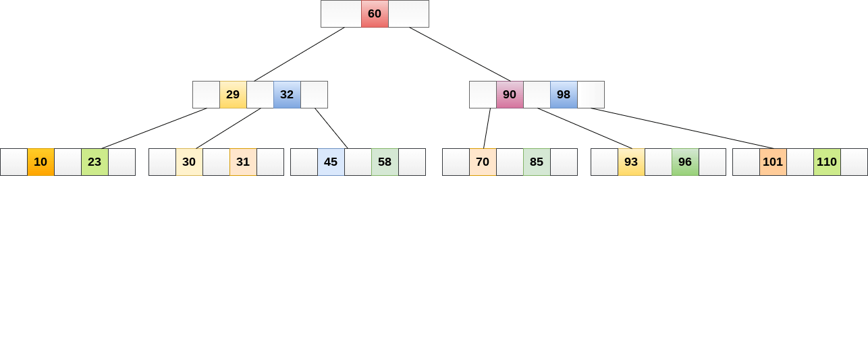
A B tree of order 4 is shown in the following image.
While performing some operations on B Tree, any property of B Tree may violate such as number of minimum children a node can have. To maintain the properties of B Tree, the tree may split or join.

Slide 15
Operations
Searching :
Searching in B Trees is similar to that in Binary search tree. For example, if we search for an item 49 in the following B Tree. The process will something like following :
  Compare item 49 with root node 78. since 49 < 78 hence, move to its left sub-tree.
  Since, 40<49<56, traverse right sub-tree of 40.
  49>45, move to right. Compare 49.
  match found, return.
Searching in a B tree depends upon the height of the tree. The search algorithm takes O(log n) time to search any element in a B tree.

Slide 16
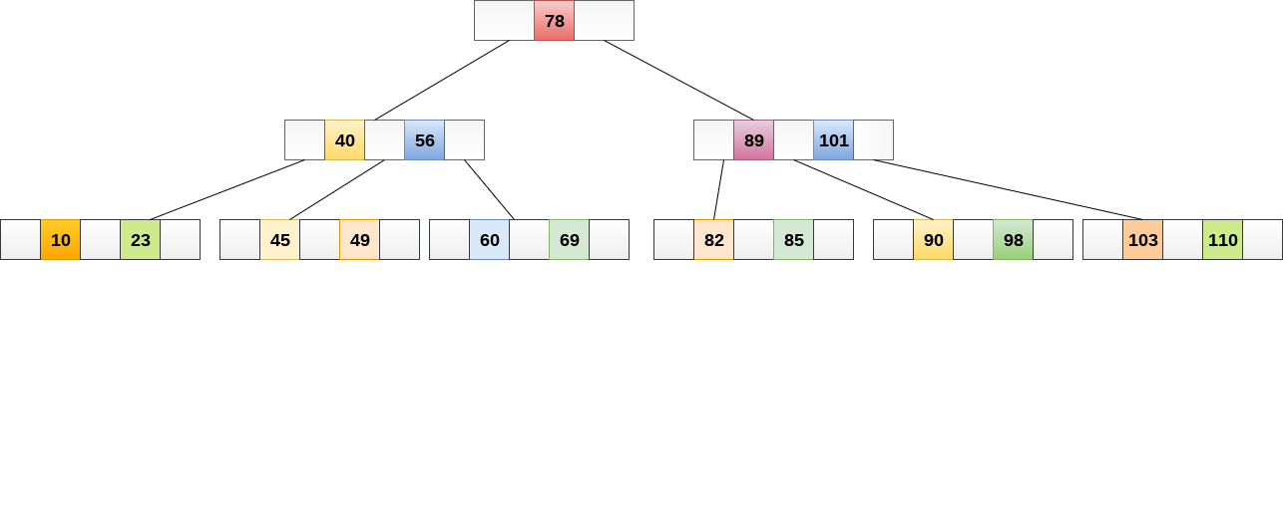

Slide 17
Insertions are done at the leaf node level. The following algorithm needs to be followed in order to insert an item into B Tree.
Traverse the B Tree in order to find the appropriate leaf node at which the node can be inserted.
If the leaf node contain less than m-1 keys then insert the element in the increasing order.
Else, if the leaf node contains m-1 keys, then follow the following steps.
  Insert the new element in the increasing order of elements.
  Split the node into the two nodes at the median.
  Push the median element upto its parent node.
  If the parent node also contain m-1 number of keys, then split it too by following the same steps.

Slide 18
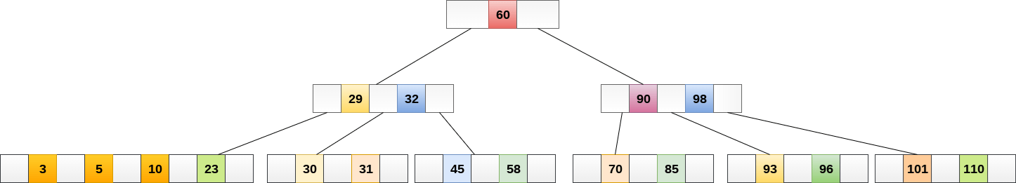
Example:
Insert the node 8 into the B Tree of order 5 shown in the following image.

Slide 19
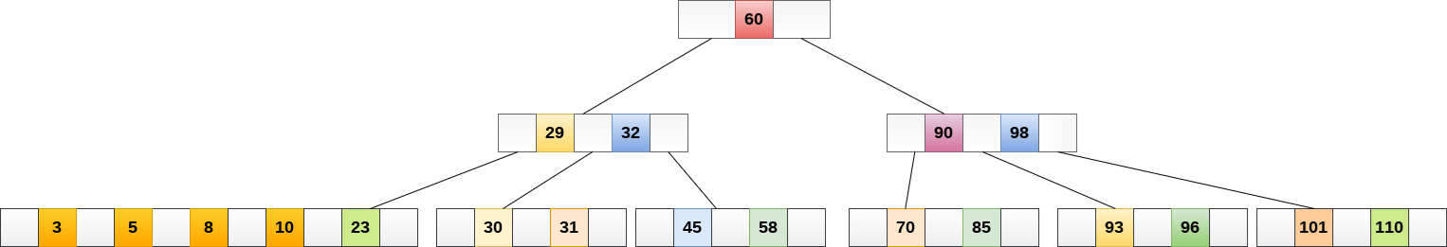
8 will be inserted to the right of 5, therefore insert 8.
The node, now contain 5 keys which is greater than (5 -1 = 4 ) keys. Therefore split the node from the median i.e. 8 and push it up to its parent node shown as follows.

Slide 20
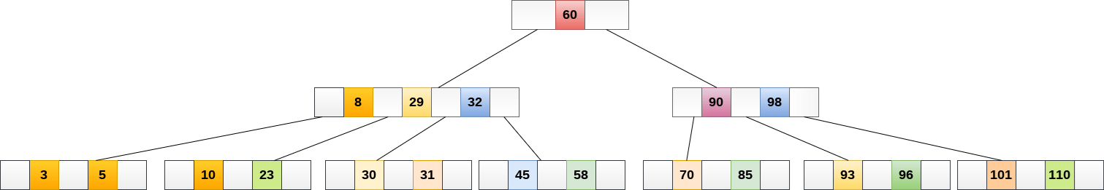

Slide 21
Deletion is also performed at the leaf nodes. The node which is to be deleted can either be a leaf node or an internal node.
Following algorithm needs to be followed in order to delete a node from a B tree.
Locate the leaf node.
If there are more than m/2 keys in the leaf node then delete the desired key from the node.

Slide 22
If the leaf node doesn't contain m/2 keys then complete the keys by taking the element from eight or left sibling.
  If the left sibling contains more than m/2 elements then push its largest element up to its parent and move the intervening element down to the node where the key is deleted.
  If the right sibling contains more than m/2 elements then push its smallest element up to the parent and move intervening element down to the node where the key is deleted.
If neither of the sibling contain more than m/2 elements then create a new leaf node by joining two leaf nodes and the intervening element of the parent node.
If parent is left with less than m/2 nodes then, apply the above process on the parent too.

Slide 23
If the the node which is to be deleted is an internal node, then replace the node with its in-order successor or predecessor.
Since, successor or predecessor will always be on the leaf node hence, the process will be similar as the node is being deleted from the leaf node.
Example 1
Delete the node 53 from the B Tree of order 5 shown in the following figure.

Slide 24

53 is present in the right child of element 49. Delete it.

Slide 25
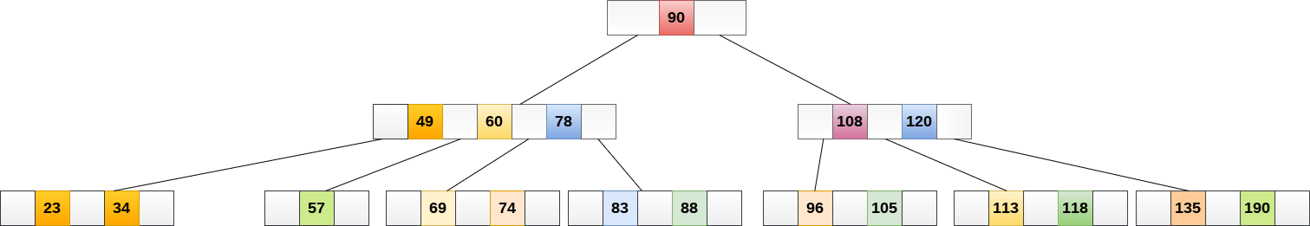
Now, 57 is the only element which is left in the node, the minimum number of elements that must be present in a B tree of order 5, is 2. it is less than that, the elements in its left and right sub-tree are also not sufficient therefore, merge it with the left sibling and intervening element of parent i.e. 49.

Slide 26
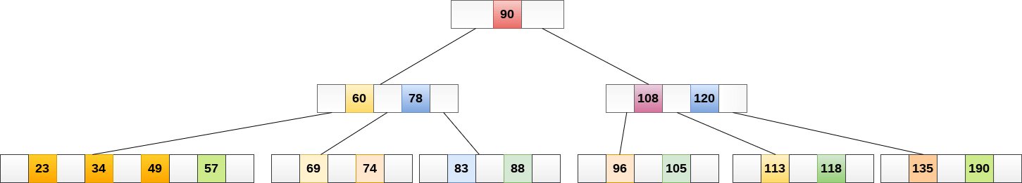
The final B tree is shown as follows.

Slide 27
Application of B tree
B tree is used to index the data and provides fast access to the actual data stored on the disks since, the access to value stored in a large database that is stored on a disk is a very time consuming process.
Searching an un-indexed and unsorted database containing n key values needs O(n) running time in worst case. However, if we use B Tree to index this database, it will be searched in O(log n) time in worst case.

Slide 28
B+ Tree
B+ Tree is an extension of B Tree which allows efficient insertion, deletion and search operations.
In B Tree, Keys and records both can be stored in the internal as well as leaf nodes. Whereas, in B+ tree, records (data) can only be stored on the leaf nodes while internal nodes can only store the key values.
The leaf nodes of a B+ tree are linked together in the form of a singly linked lists to make the search queries more efficient.
B+ Tree are used to store the large amount of data which can not be stored in the main memory. Due to the fact that, size of main memory is always limited, the internal nodes (keys to access records) of the B+ tree are stored in the main memory whereas, leaf nodes are stored in the secondary memory.

Slide 29
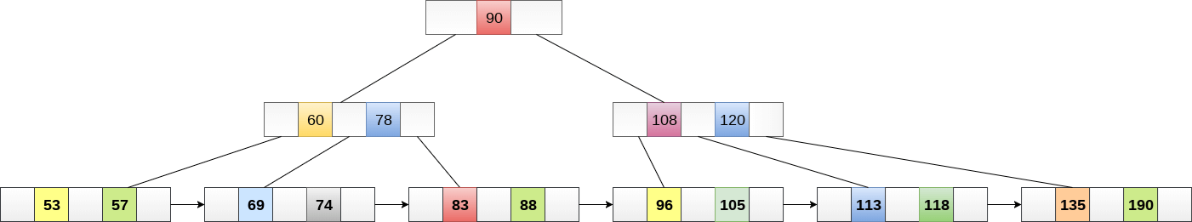
The internal nodes of B+ tree are often called index nodes. A B+ tree of order 3 is shown in the following figure.

Slide 30
Advantages of B+ Tree
Records can be fetched in equal number of disk accesses.
Height of the tree remains balanced and less as compare to B tree.
We can access the data stored in a B+ tree sequentially as well as directly.
Keys are used for indexing.
Faster search queries as the data is stored only on the leaf nodes.

Slide 31
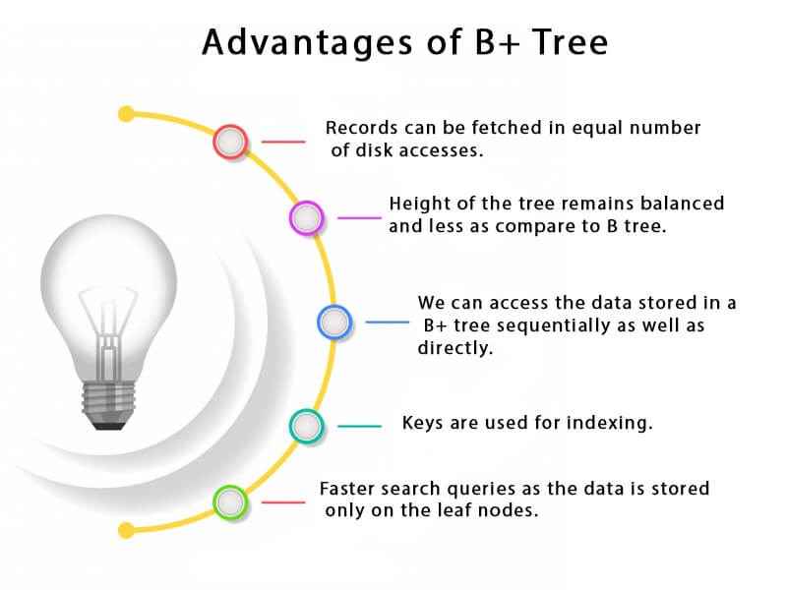

Slide 32
SN | B Tree | B+ Tree
1 | Search keys can not be repeatedly stored. | Redundant search keys can be present.
2 | Data can be stored in leaf nodes as well as internal nodes | Data can only be stored on the leaf nodes.
3 | Searching for some data is a slower process since data can be found on internal nodes as well as on the leaf nodes. | Searching is comparatively faster as data can only be found on the leaf nodes.
4 | Deletion of internal nodes are so complicated and time consuming. | Deletion will never be a complexed process since element will always be deleted from the leaf nodes.
5 | Leaf nodes can not be linked together. | Leaf nodes are linked together to make the search operations more efficient.

Slide 33
Insertion in B+ Tree
Step 1: Insert the new node as a leaf node
Step 2: If the leaf doesn't have required space, split the node and copy the middle node to the next index node.
Step 3: If the index node doesn't have required space, split the node and copy the middle element to the next index page.

Slide 34
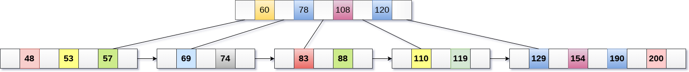
Example :
Insert the value 195 into the B+ tree of order 5 shown in the following figure.

Slide 35
195 will be inserted in the right sub-tree of 120 after 190. Insert it at the desired position.

Slide 36
The node contains greater than the maximum number of elements i.e. 4, therefore split it and place the median node up to the parent.

Slide 37
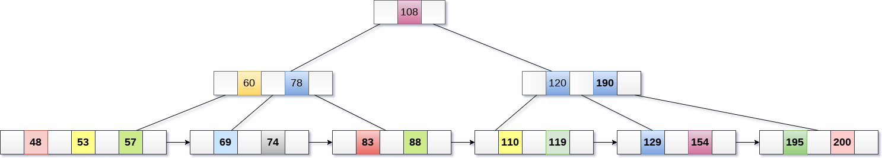
Now, the index node contains 6 children and 5 keys which violates the B+ tree properties, therefore we need to split it, shown as follows.

Slide 38
Deletion in B+ Tree
Step 1: Delete the key and data from the leaves.
Step 2: if the leaf node contains less than minimum number of elements, merge down the node with its sibling and delete the key in between them.
Step 3: if the index node contains less than minimum number of elements, merge the node with the sibling and move down the key in between them.

Slide 39

Example
Delete the key 200 from the B+ Tree shown in the following figure.

Slide 40
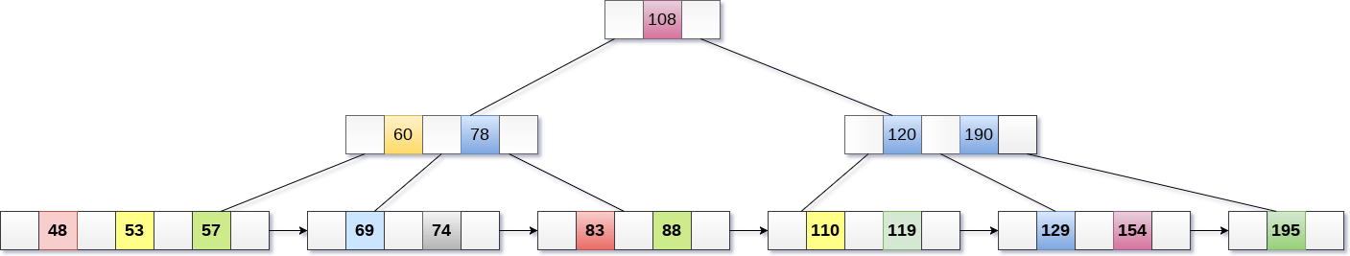
200 is present in the right sub-tree of 190, after 195. delete it.

Slide 41
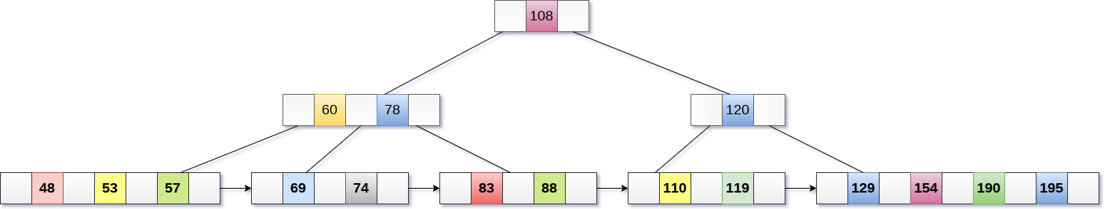
Merge the two nodes by using 195, 190, 154 and 129.

Slide 42

Now, element 120 is the single element present in the node which is violating the B+ Tree properties.
Therefore, we need to merge it by using 60, 78, 108 and 120.
Now, the height of B+ tree will be decreased by 1.

Slide 43
AVL Tree
AVL Tree is invented by GM Adelson - Velsky and EM Landis in 1962. The tree is named AVL in honour of its inventors.
AVL Tree can be defined as height balanced binary search tree in which each node is associated with a balance factor which is calculated by subtracting the height of its right sub-tree from that of its left sub-tree.
Tree is said to be balanced if balance factor of each node is in between -1 to 1, otherwise, the tree will be unbalanced and need to be balanced.
Balance Factor (k) = height (left(k)) - height (right(k))
If balance factor of any node is 1, it means that the left sub-tree is one level higher than the right sub-tree.

Slide 44
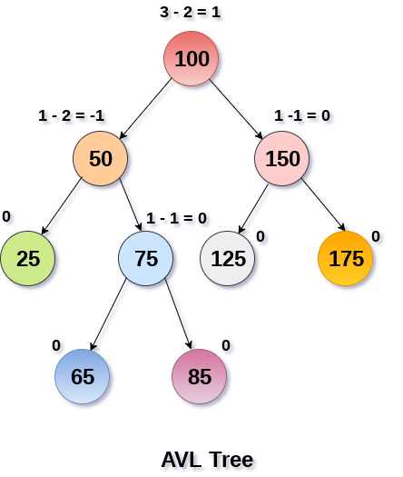
If balance factor of any node is 0, it means that the left sub-tree and right sub-tree contain equal height.
If balance factor of any node is -1, it means that the left sub-tree is one level lower than the right sub-tree.
An AVL tree is given in the following figure. We can see that, balance factor associated with each node is in between -1 and +1. therefore, it is an example of AVL tree.

Slide 45
Complexity
Algorithm | Average case | Worst case
Space | o(n) | o(n)
Search | o(log n) | o(log n)
Insert | o(log n) | o(log n)
Delete | o(log n) | o(log n)

Slide 46
Operations on AVL tree
Due to the fact that, AVL tree is also a binary search tree therefore, all the operations are performed in the same way as they are performed in a binary search tree.
Searching and traversing do not lead to the violation in property of AVL tree. However, insertion and deletion are the operations which can violate this property and therefore, they need to be revisited.
SN | Operation | Description
1 | Insertion | Insertion in AVL tree is performed in the same way as it is performed in a binary search tree. However, it may lead to violation in the AVL tree property and therefore the tree may need balancing. The tree can be balanced by applying rotations.
2 | Deletion | Deletion can also be performed in the same way as it is performed in a binary search tree. Deletion may also disturb the balance of the tree therefore, various types of rotations are used to rebalance the tree.

Slide 47
AVL Rotations
We perform rotation in AVL tree only in case if Balance Factor is other than -1, 0, and 1. There are basically four types of rotations which are as follows:
L L rotation: Inserted node is in the left subtree of left subtree of A
R R rotation : Inserted node is in the right subtree of right subtree of A
L R rotation : Inserted node is in the right subtree of left subtree of A
R L rotation : Inserted node is in the left subtree of right subtree of A
Where node A is the node whose balance Factor is other than -1, 0, 1.
The first two rotations LL and RR are single rotations and the next two rotations LR and RL are double rotations. For a tree to be unbalanced, minimum height must be at least 2, Let us understand each rotation

Slide 48
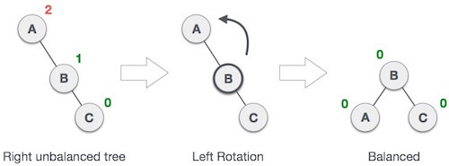
RR Rotation
When BST becomes unbalanced, due to a node is inserted into the right subtree of the right subtree of A, then we perform RR rotation, RR rotation is an anticlockwise rotation, which is applied on the edge below a node having balance factor -2
In above example, node A has balance factor -2 because a node C is inserted in the right subtree of A right subtree. We perform the RR rotation on the edge below A.

Slide 49
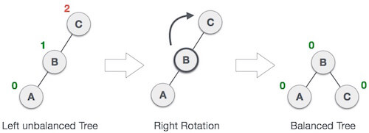
LL Rotation
When BST becomes unbalanced, due to a node is inserted into the left subtree of the left subtree of C, then we perform LL rotation, LL rotation is clockwise rotation, which is applied on the edge below a node having balance factor 2.
In above example, node C has balance factor 2 because a node A is inserted in the left subtree of C left subtree. We perform the LL rotation on the edge below A.

Slide 50
LR Rotation
Double rotations are bit tougher than single rotation which has already explained above. LR rotation = RR rotation + LL rotation, i.e., first RR rotation is performed on subtree and then LL rotation is performed on full tree, by full tree we mean the first node from the path of inserted node whose balance factor is other than -1, 0, or 1.

Slide 51

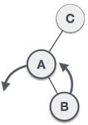
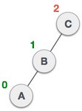
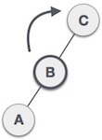
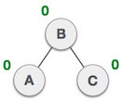
State | Action
 | A node B has been inserted into the right subtree of A the left subtree of C, because of which C has become an unbalanced node having balance factor 2. This case is L R rotation where: Inserted node is in the right subtree of left subtree of C
 | As LR rotation = RR + LL rotation, hence RR (anticlockwise) on subtree rooted at A is performed first. By doing RR rotation, node A, has become the left subtree of B.
 | After performing RR rotation, node C is still unbalanced, i.e., having balance factor 2, as inserted node A is in the left of left of C
 | Now we perform LL clockwise rotation on full tree, i.e. on node C. node C has now become the right subtree of node B, A is left subtree of B
 | Balance factor of each node is now either -1, 0, or 1, i.e. BST is balanced now.

Slide 52
RL Rotation
double rotations are bit tougher than single rotation which has already explained above. R L rotation = LL rotation + RR rotation, i.e., first LL rotation is performed on subtree and then RR rotation is performed on full tree, by full tree we mean the first node from the path of inserted node whose balance factor is other than -1, 0, or 1.

Slide 53


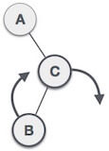
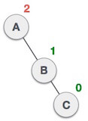
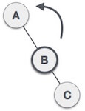
State | Action
 | A node B has been inserted into the left subtree of C the right subtree of A, because of which A has become an unbalanced node having balance factor - 2. This case is RL rotation where: Inserted node is in the left subtree of right subtree of A
 | As RL rotation = LL rotation + RR rotation, hence, LL (clockwise) on subtree rooted at C is performed first. By doing RR rotation, node C has become the right subtree of B.
 | After performing LL rotation, node A is still unbalanced, i.e. having balance factor -2, which is because of the right-subtree of the right-subtree node A.
 | Now we perform RR rotation (anticlockwise rotation) on full tree, i.e. on node A. node C has now become the right subtree of node B, and node A has become the left subtree of B.
 | Balance factor of each node is now either -1, 0, or 1, i.e., BST is balanced now.

Slide 54
Comparison between B Tree and B+ Tree:
 | B Tree | B+ Tree
Short web descriptions | A B tree is an organizational structure for information storage and retrieval in the form of a tree in which all terminal nodes are at the same distance from the base, and all non-terminal nodes have between n and 2 n sub-trees or pointers (where n is an integer). | B+ tree is an n-array tree with a variable but often large number of children per node. A B+ tree consists of a root, internal nodes and leaves. The root may be either a leaf or a node with two or more children.
Also known as | Balanced tree. | B plus tree.
Space | O(n) | O(n)
Search | O(log n) | O(log_{b} n)
Insert | O(log n) | O(log_{b} n)
Delete | O(log n) | O(log_{b} n)

Slide 55
Storage | In a B tree, search keys and data stored in internal or leaf nodes. | In a B+ tree, data stored only in leaf nodes.
Data | The leaf nodes of the three store pointers to records rather than actual records. | The leaf nodes of the tree stores the actual record rather than pointers to records.
Space | These trees waste space | There trees do not waste space.

Slide 56
Function of leaf nodes | In B tree, the leaf node cannot store using linked list. | In B+ tree, leaf node data are ordered in a sequential linked list.
Searching | Here, searching becomes difficult in B- tree as data cannot be found in the leaf node. | Here, searching of any data in a B+ tree is very easy because all data is found in leaf nodes.
Search accessibility | Here in B tree the search is not that easy as compared to a B+ tree. | Here in B+ tree the searching becomes easy.
Redundant key | They do not store redundant search key. | They store redundant search key.
Applications | They are an older version and are not that advantageous as compared to the B+ trees. | Many database system implementers prefer the structural simplicity of a B+ tree.

Slide 57
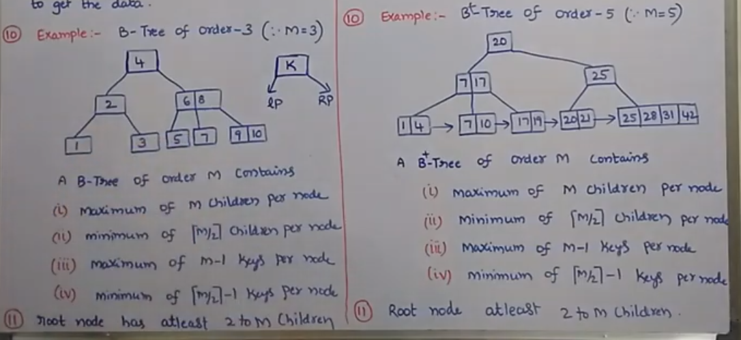
1 | In B-Tree keys and records can be stored in internal nodes as well as leaf nodes | In B+ -Tree records are stored in leaf nodes and the keys are stored in internal nodes
2 | In B-Tree keys cannot be repeatedly stored | In B+ -Tree redundant keys may be present
3 | In B-Tree leaf nodes are not linked together | In B+ -Tree , leaf nodes are linked to each other
4 | In B-Tree , searching is slow because records are stored on leaf and internal nodes | In B+ -Tree, leaf nodes are linked together to make the search more accurate and faster
5 | In B-Tree , deletion of internal nodes is a complicated and time consuming process | In B+ -Tree, deletion is not difficult because keys are removed from the leaf nodes
6 | Operations on B-Tree are performed slower | Operation on B+ -Tree are performed faster than B-Tree
7 | In B-Tree , sequential access of data or record not possible | In B+ -Tree, sequential access of data or records can be done fastly
8 | B-Tree has more height compared to width | B+ -Tree has more width compared to height
9 | In B-Tree ,each node will have atleast two branches and each node will have some record, hence there is no need to traverse till leaf node to get the data | In B+ -Tree,internal nodes contains only pointers to the leaf nodes. all leaf nodes will have records and all are at same distance from the root.all leaf node are at the same level
10 | In B-Tree | In B+ -Tree

